Slide 1



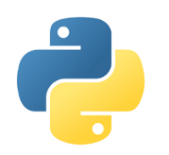
Tokyo.R #80
2019.07.27
R Interface to Python
kilometer00

Slide 2

Who！？
誰だ？

Slide 3
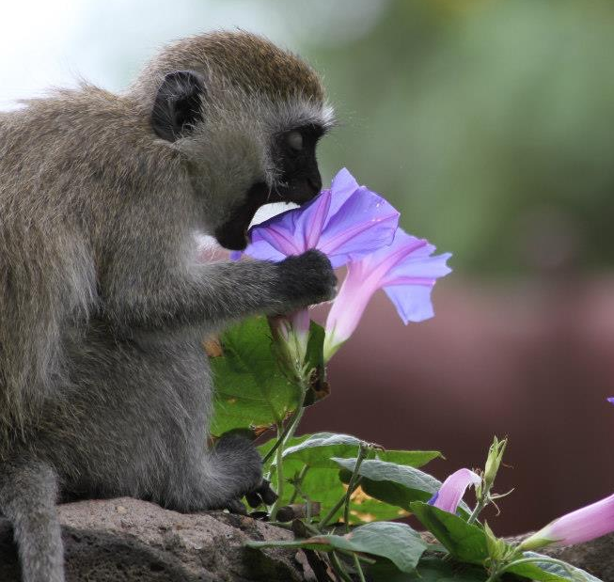
Who！？
名前： 三村 @kilometer
職業： ポスドク (こうがくはくし)
専門： 行動神経科学(霊長類)
脳イメージング
医療システム工学
R歴： ~ 10年ぐらい
流行: カメ

Slide 4
2018.07.15 Tokyo.R #71 Landscape with R – the Japanese R community
2018.10.20 Tokyo.R #73 BeginneR Session – Visualization & Plot
2019.01.19 Tokyo.R #75 BeginneR Session – Data pipeline
2019.03.02 Tokyo.R #76 BeginneR Session – Data pipeline
2019.04.13 Tokyo.R #77 BeginneR Session – Data analysis
2019.05.25 Tokyo.R #78 BeginneR Session – Data analysis
2019.06.29 Tokyo.R #79 BeginneR Session – 確率の基礎

Slide 5




BeginneR Session
BeginneR
BeginneR
Before
After

Slide 6



BeginneR
Advanced
Hoxo_m
If I have seen further it is by standing on the shoulders of Giants.
-- Sir Isaac Newton, 1676

Slide 7
R Interface to Python

Slide 8
一昔前
私もそろそろ
を、始めたいんだけど。
ぱそこん
できるんでしょ？教えてよ。
いいけど、
ぱそこん
で何がしたいの？
ぱそこん
って何でもできるんでしょ？
でも、どうしたらいいか分かんないんだ。

Slide 9
最近
私もそろそろ
を、始めたいんだけど。
じんこう
ちのー
できるんでしょ？教えてよ。
じんこう
ちのー
いいけど、
で何がしたいの？
じんこう
ちのー
って何でもできるんでしょ？
でも、どうしたらいいか分かんないんだ。

Slide 10
私もそろそろ
を、始めたいんだけど。
できるんでしょ？教えてよ。
いいけど、
で何がしたいの？
って何でもできるんでしょ？
でも、どうしたらいいか分かんないんだ。

Slide 11

私もそろそろ
を、始めたいんだけど。
できるんでしょ？教えてよ。
いいけど、
で何がしたいの？
って何でもできるんでしょ？
でも、どうしたらいいか分かんないんだ。

Slide 12

Do NOT start from here
Input
Output

Slide 13

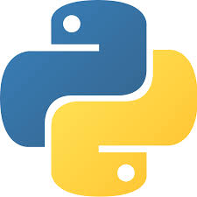
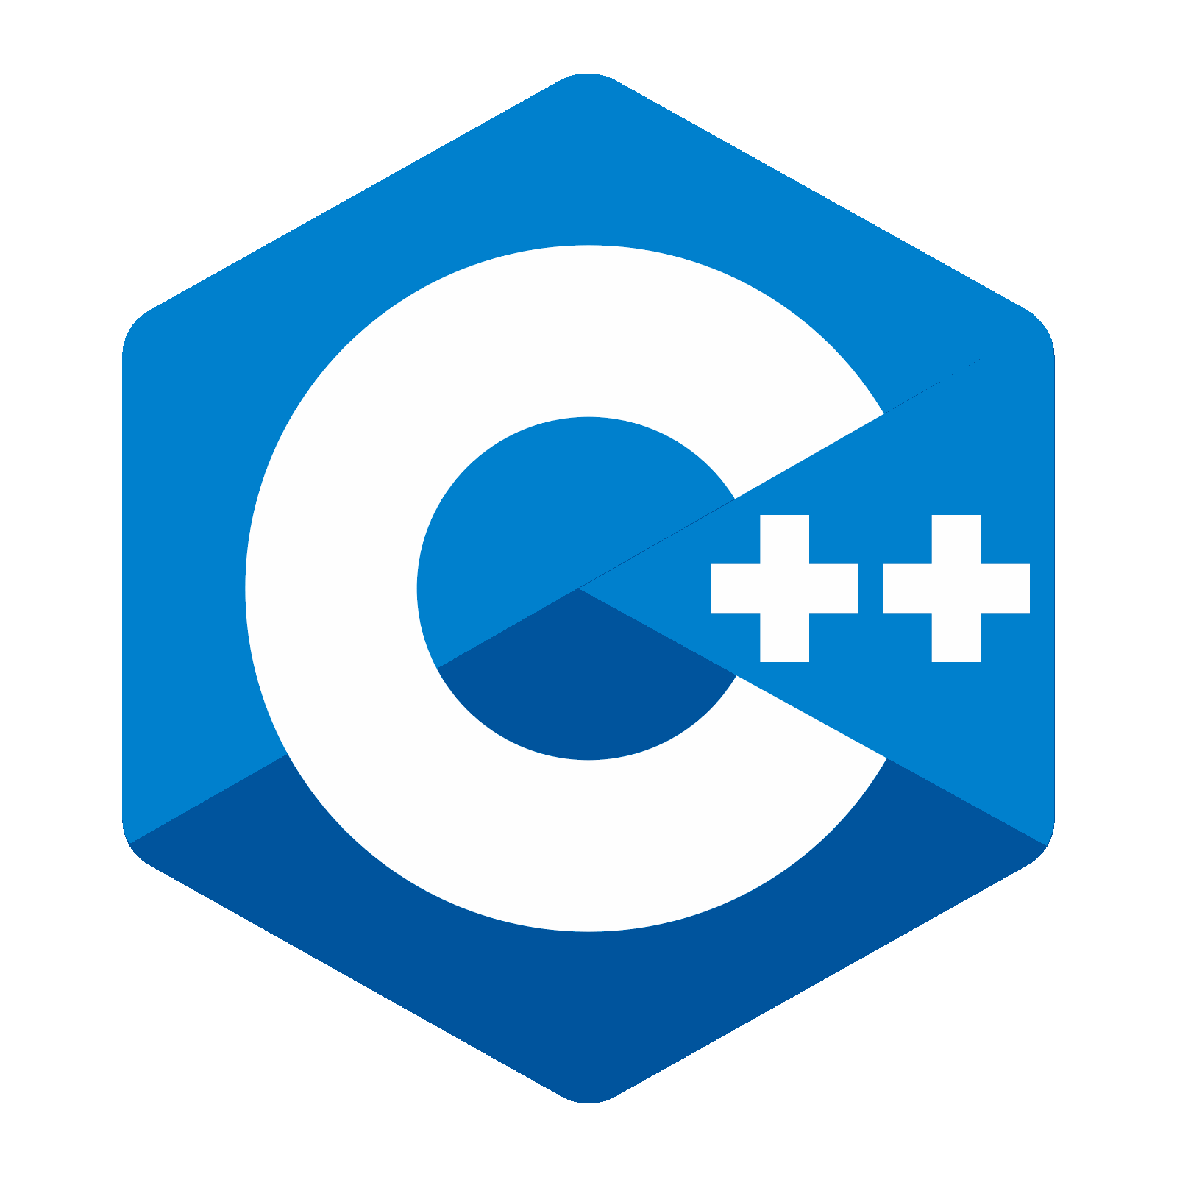
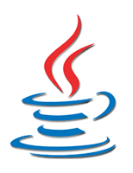
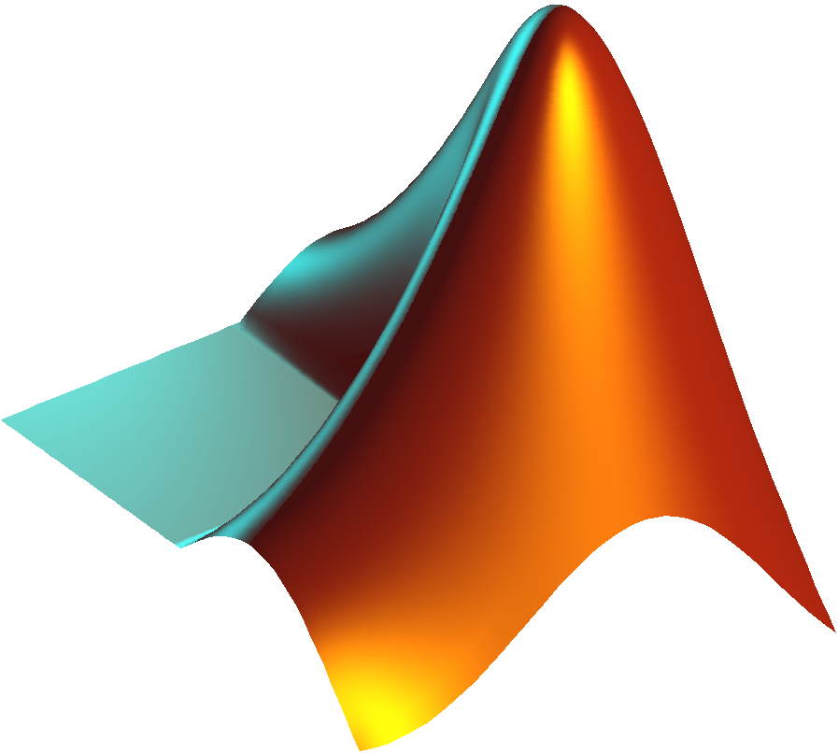
Do NOT start from here
Input
Whatever
Output
…

Slide 14
2
Do NOT start from here
Input
3
1
Whatever
Output
…

Slide 15

Input
Output

Slide 16
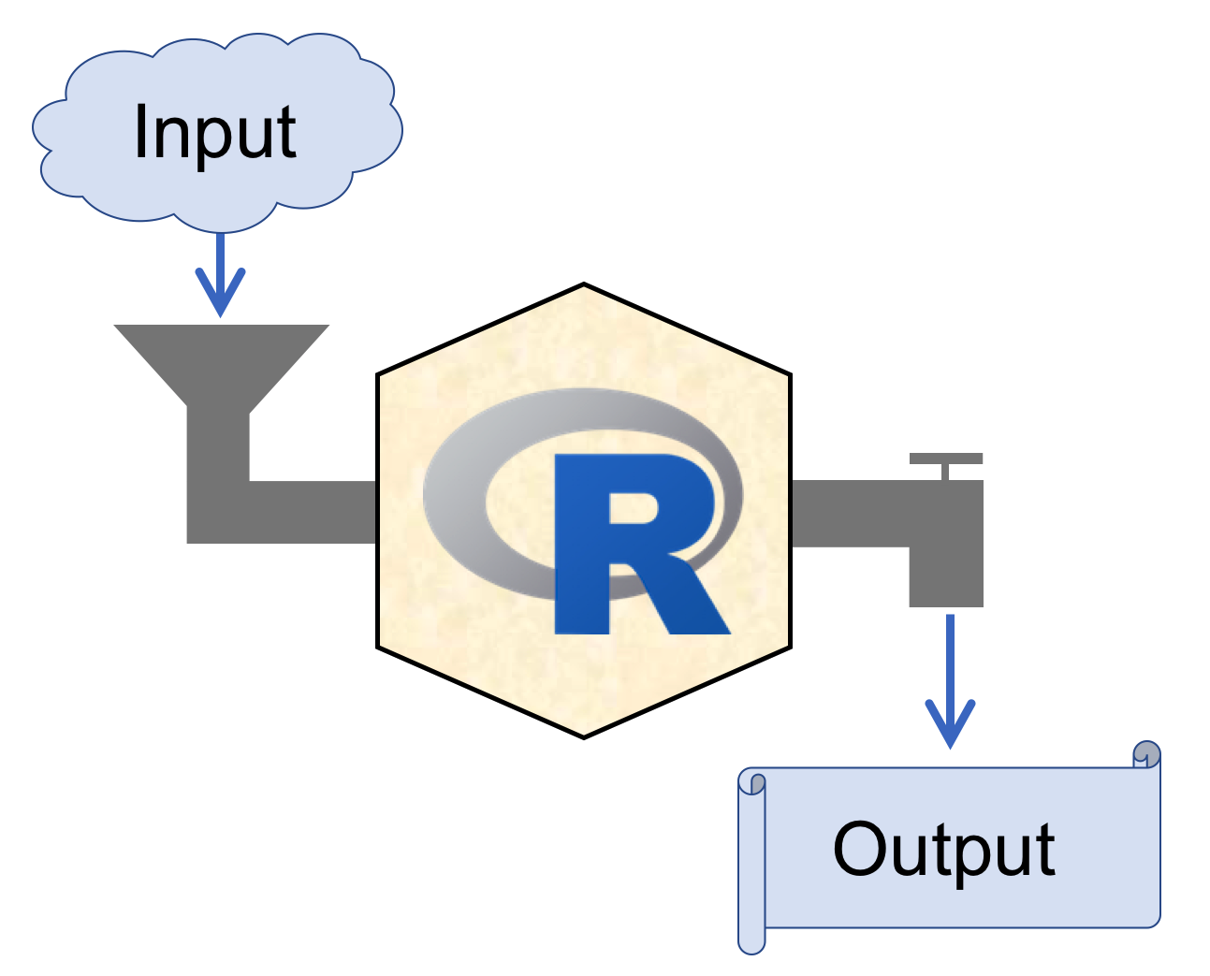

RStudio
https://www.rstudio.com/
Recommended!!
Integrated Development Environment

Slide 17
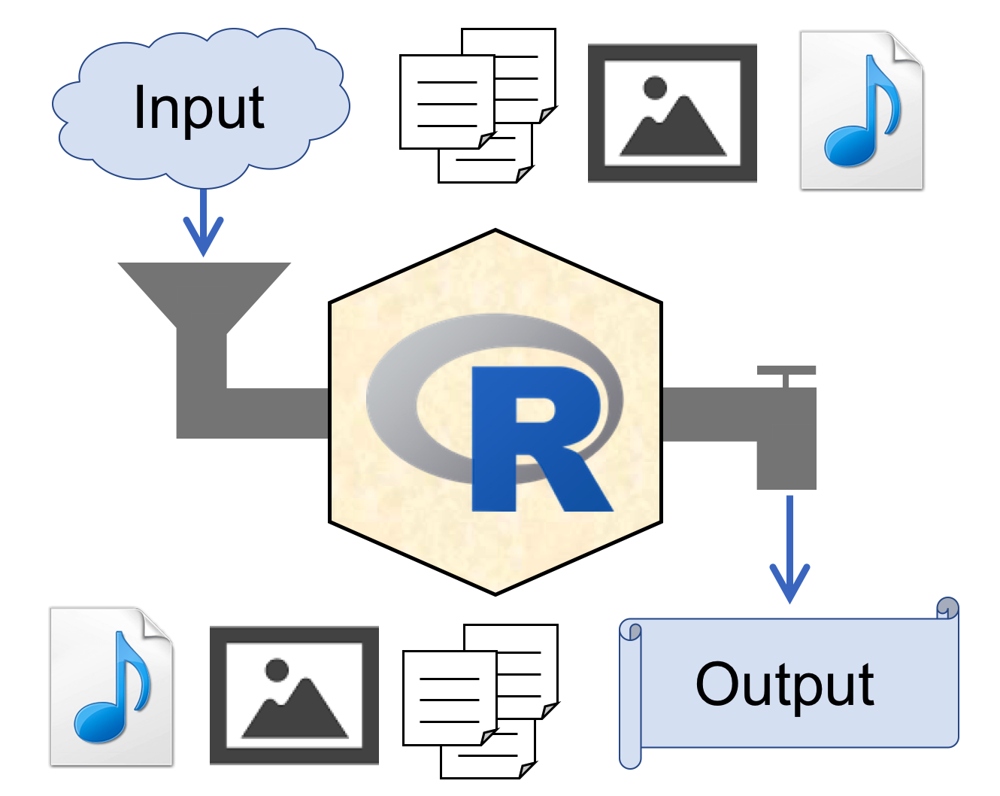
RStudio
https://www.rstudio.com/
Integrated Development Environment

Slide 18
RStudio

Slide 19
RStudio
Projects

Slide 20
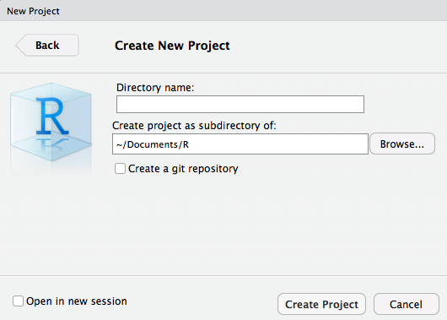
File > New Project… > New Directory > New Project
hogehoge

Slide 21



~/Documents/R
Project Root Directory
New!!
hogehoge
Double click!!
hogehoge.Rproj
Open project
.Rproj.user
Auto saved
project information
.RData
.Rhistory

Slide 22
~/Documents/R
project3
project1
project4
project2

Slide 23
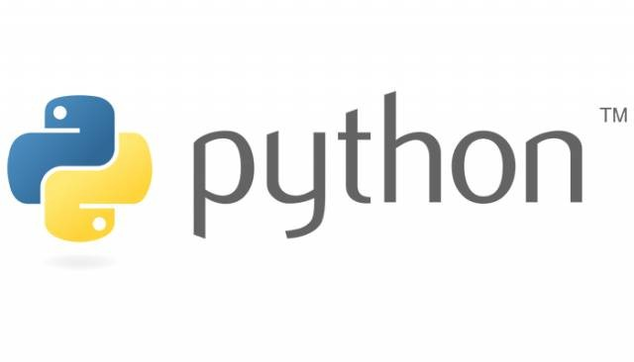

Slide 24


Variable assignment
var <- 1
var = 1
1 -> var
var = 1

Slide 25
Variable naming
1var = 1
1var <- 1
_var = 1
_var <- 1
.var = 1
.var <- 1
var.1 = 1
var.1 <- 1
list = 1
list <- 1

Slide 26


Variable naming
1var = 1
1var <- 1
_var = 1
_var <- 1
.var = 1
.var <- 1
var.1 = 1
var.1 <- 1
list = 1
list <- 1
(reserved)
(reserved)

Slide 27
Variable type
String
Character
var <- "1"
var <- "1"
Integer
Integer
var <- 1
var <- 1L
Float
Double
var <- 1.0
var <- 1
var <- 1.0

Slide 28
Variable type
String
Character
var <- "1"
var <- "1"
Integer
Integer
var <- 1
var <- 1L
Float
Double
var <- 1.0
var <- 1
var <- 1.0

Slide 29
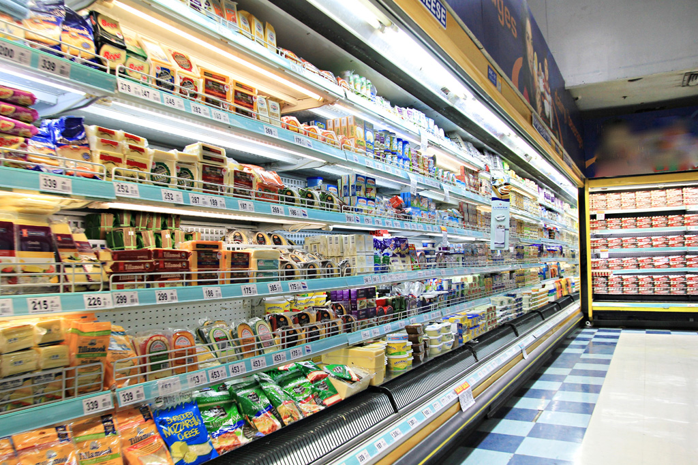


Packages
packages
you

Slide 30
Packages
import numpy
numpy.array([1:3])
library(dplyr)
filter(dat, ...)

Slide 31
Packages
import numpy
numpy.array([1:3])
library(dplyr)
filter(dat, ...)
import numpy as np np.array([1:3])
dplyr::filter(dat, ...)

Slide 32
Packages
import numpy
numpy.array([1:3])
library(dplyr)
filter(dat, ...)
import numpy as np np.array([1:3])
dplyr::filter(dat, ...)
from numpy import array array([1:3])

Slide 33


Loop
for i in range(10): i = i + 1
for(i in 1:10){
i = i + 1 }
for i in range(10):
i = i + 1
INDENT ERROR
for(i in 1:10)
i = i + 1
for i in range(10): i += 1
One-liner case

Slide 34
Function definition
def f(x, y = 1): z = x + y
return z
f <- function(x, y = 1){
z = x + y
return(z) }
f <- function(x, y = 1){
z = x + y
# return(z) }
CHECK YOUR INDENT
Autoreturn the final expression (z)

Slide 35


Slide 36


$$≈$$

Slide 37
reticulate package
URL: https://github.com/rstudio/reticulate

Slide 38
reticulate package
Calling Python from R in a variety of ways including R Markdown, sourcing Python scripts, importing Python modules, and using Python interactively within an R session.
Translation between R and Python objects (for example, between R and Pandas data frames, or between R matrices and NumPy arrays).
URL: https://github.com/rstudio/reticulate

Slide 39
Environment setup
for Python
(in macOS Mojave 10.14.3)

Slide 40

Sandbox

Slide 41
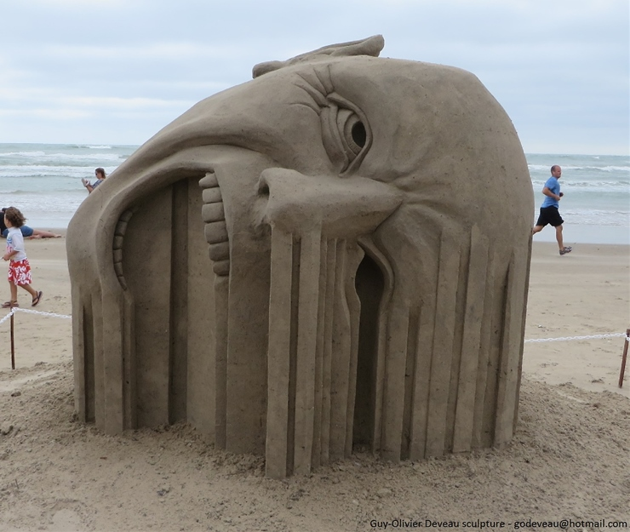

http://buzz-plus.com/2014/07/25/suna/
Sandbox
http://www.sandart-j.com/work/work3.html

Slide 42
Sandbox A
http://buzz-plus.com/2014/07/25/suna/
Sandbox B
http://www.sandart-j.com/work/work3.html

Slide 43
Sandbox A
Isolated
&
Independent
http://buzz-plus.com/2014/07/25/suna/
Sandbox B
http://www.sandart-j.com/work/work3.html

Slide 44
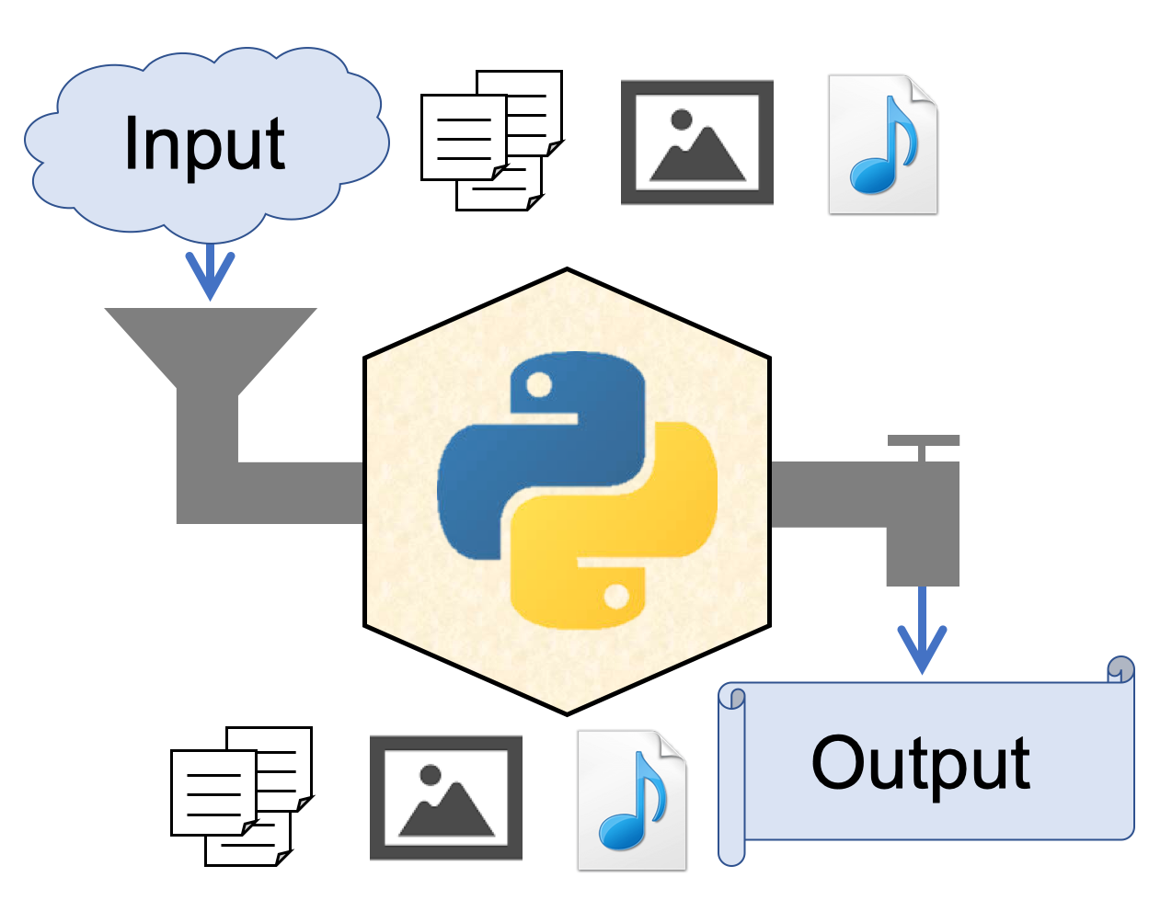
"Sandboxed" Python
Isolated & Independent virtual environment for secure and reproducibility
A sandbox is a type of software testing environment that enables the isolated execution of software or programs for independent evaluation, monitoring or testing.

Slide 45
RStudio
Projects

Slide 46
"Sandboxed" Python
Isolated & Independent virtual environment for security & reproducibility
[python]
version = "3.7"
[packages]
cycler==0.10.0
kiwisolver==1.1.0
matplotlib==3.1.1
numpy==1.16.4
opencv-python==4.1.0.25
pandas==0.25.0
pyparsing==2.4.0
PypeR==1.1.2 ...
[python]
version = "2.7"
[packages]
numpy==1.16.4
...

Slide 47
Pipenv
→ "Sandboxed" Python manager
Install Python
Recommended!!
https://www.python.org/
Install Pipenv (in MacOS)
$ brew install pipenv

Slide 48
Pipenv
→ "Sandboxed" Python manager
Create virtualenv
$ cd <project root>
$ pipenv --python 3.7
<project root>
.venv
← interpreter, env info
Pipfile
← package info

Slide 49
Pipenv
→ "Sandboxed" Python manager
Activate virtualenv
$ pipenv shell
Deactivate virtualenv
(prj) $ exit
Delete virtualenv
$ pipenv --rm

Slide 50
Pipenv
→ "Sandboxed" Python manager
Activate virtualenv
$ pipenv shell
Install packages
(prj) $ pipenv install <pkg>~=<version>
Uninstall packages
(prj) $ pipenv uninstall <pkg>

Slide 51
For {reticulate},
you need NumPy package
in your virtualenv.

Slide 52
Pipenv
→ "Sandboxed" Python manager
Install NumPy
$ cd <prj>
$ pipenv shell
(prj) $ pipenv install numpy
# activate
# install
(prj) $ pipenv run pip freeze
# check
(prj) $ python
>>> import numpy
# check

Slide 53
Pipenv
→ "Sandboxed" Python manager
Address of the virtualenv
$ cd <prj>
$ pipenv shell
(prj) $ pipenv --venv
<prj>/.venv
# activate
# check

Slide 54
back to

Slide 55
Use Python in R
Install reticulate from CRAN
install.packages(reticulate)
Attach Python virtualenv
library(reticulate)
pyenv <- "<prj>/.venv/bin/python"
use_python(python = pyenv, required = TRUE)

Slide 56
Use Python in R
Check your Python
py_config()
## python: <prj>/.venv/bin/python
## libpython: /Library/Frameworks/Python.framework...
## pythonhome: /Library/Frameworks/Python.fram...
## virtualenv: <prj>/.venv/bin/activate_this.py
## version: 3.7.4 (v3.7.4:e09359112e, Jul 8 2019...
## numpy: <prj>/.venv/lib/python3.7/site-packages/...
## numpy_version: 1.16.4
##
## NOTE: Python version was forced by use_python...

Slide 57
Use Python in R
Import Python pkg in R
os <- import("os")
Use Python pkg in R
os$listdir()
## [1] ".Rhistory" ".DS_Store"
## [2] ".gitignore" ".RData"
## ...

Slide 58
Use Python in R
Import Python source file
source_python("sample.py")
import pandas as pd
def pd_load_csv(path):
df = pd.read_csv(path)
return df
def pd_head(df, n = 3):
return df.head(n)
sample.py
File > New File > Python script

Slide 59
Use Python in R
Import Python source
source_python("sample.py")
dat <- pd_load_csv("hoge.csv")
pd_head(dat)
iris %>% pd_head

Slide 60
Benchmark test
source_python("sample.py")
f_pd <- function(path) pd_load_csv(path)
f_base <- function(path) read.csv(path)
f_readr <- function(path) readr::read_csv(path)
f_fread <- function(path) data.table::fread(path)

Slide 61
Benchmark test
source_python("sample.py")
f_pd <- function(path) pd_load_csv(path)
f_base <- function(path) read.csv(path)
f_readr <- function(path) readr::read_csv(path)
f_fread <- function(path) data.table::fread(path)
microbenchmark::microbenchmark(
pd_load_csv = f_pd(path),
read.csv = f_base(path),
read_csv = f_readr(path),
fread = f_fread(path)) -> mbm
ggplot2::autoplot(mbm)

Slide 62
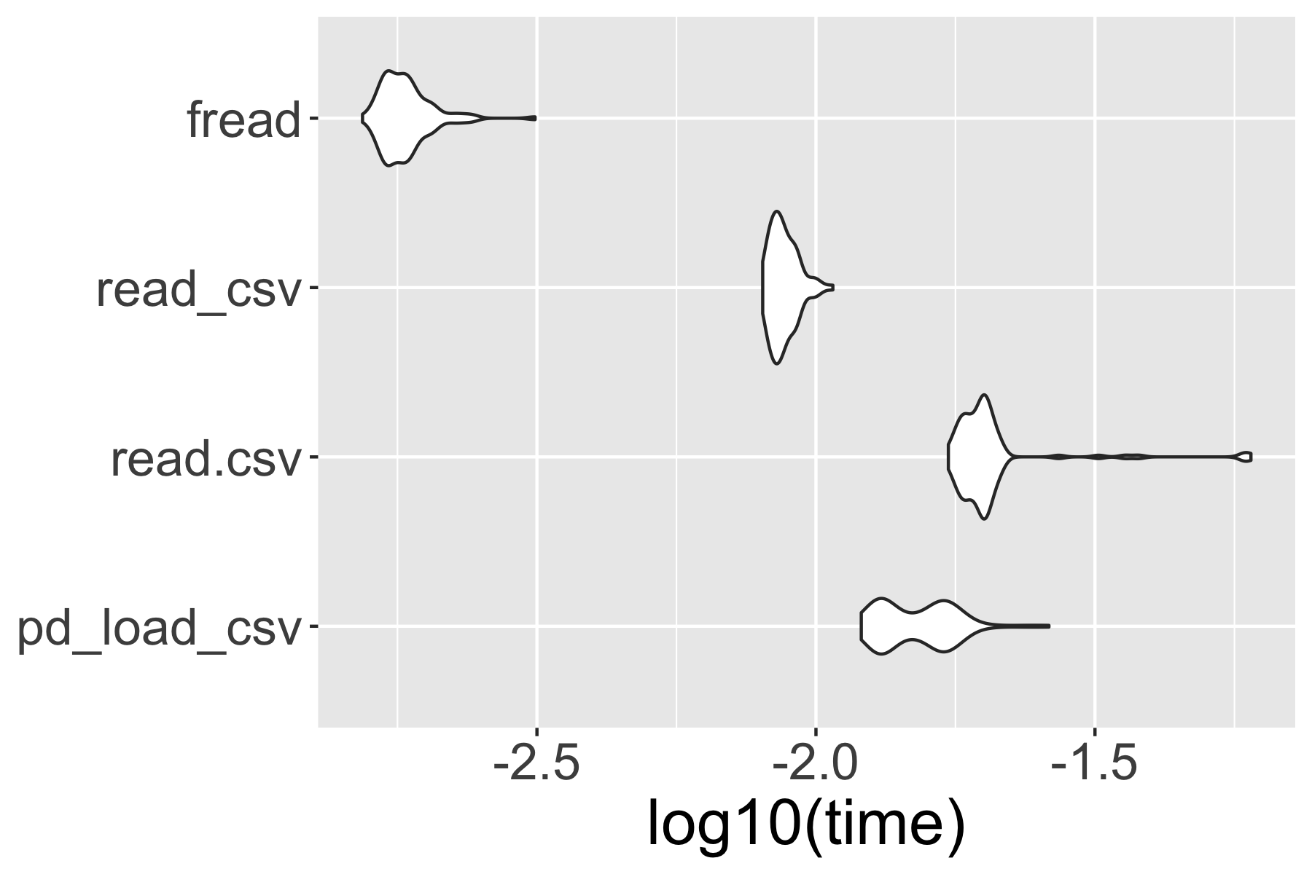
Benchmark test

Slide 63
Use Python in R
Import Python source
source_python("sample.py")
iris %>%
pd_head(5)
## y_call_impl(callable, dots$args, dots$keywords) ## でエラー:
## TypeError: cannot do slice indexing on <class
## 'pandas.core.indexes.range.RangeIndex'> with ## these indexers [5.0] of <class 'float'>

Slide 64
Variable type
String
Character
var <- "1"
var <- "1"
Integer
Integer
var <- 1
var <- 1L
Float
Double
var <- 1.0
var <- 1
var <- 1.0

Slide 65
Use Python in R
Import Python source
source_python("sample.py")
iris %>%
pd_head(5)
# type ERROR
iris %>%
pd_head(5L)
# set as integer

Slide 66
reticulate package
Calling Python from R in a variety of ways including R Markdown, sourcing Python scripts, importing Python modules, and using Python interactively within an R session.
Translation between R and Python objects (for example, between R and Pandas data frames, or between R matrices and NumPy arrays).
URL: https://github.com/rstudio/reticulate

Slide 67
reticulate package
Calling Python from R in a variety of ways including R Markdown, sourcing Python scripts, importing Python modules, and using Python interactively within an R session.
Translation between R and Python objects (for example, between R and Pandas data frames, or between R matrices and NumPy arrays).
URL: https://github.com/rstudio/reticulate

Slide 68
Use Python in Rmd
Create .Rmd file
File > New File > R markdown
Import Python virturalenv in R chunk
```{r}
library(reticulate)
pyenv <- "<prj>/.venv/bin/python"
use_python(python = pyenv, required = TRUE)
```

Slide 69
Use Python in Rmd
Use Python in python chunk
```{python}
import pandas as pd
path = "<path>/sample.csv"
df = pd.read_csv(path)
df.head(3)
```

Slide 70
Use Python in Rmd
Use Python in python chunk
```{python}
import pandas as pd
path = "<path>/sample.csv"
df = pd.read_csv(path)
df.head(3)
```
preview

Slide 71
Use Python in Rmd
Shear pyobj between pychunks
```{python}
import pandas as pd
path = "<path>/sample.csv"
df = pd.read_csv(path)
```
```{python} df.head(3) ```

Slide 72
Use Python in Rmd
Import R object to python chunk
```{python}
import pandas as pd
df = r.iris
df.head(3)
```

Slide 73
Use Python in Rmd
Import R object to python chunk
```{python}
import pandas as pd
df = r.iris
```
Import python object to R chunk
```{r}
py <- import_main()
py$df
```

Slide 74
Benchmark test in python chunk
```{python}
import pandas as pd
from time import time
path = "<path>/sample.csv"
result = []
for i in range(100):
start = time()
df = pd.read_csv(path)
time_i = time() - start
result = result.append(time_i)
```

Slide 75
Benchmark visualization in R chunk
```{r}
py <- import_main()
py$result %>% data.frame(expr = "py_pd", time = .) %>%
rbind(data.frame(mbm) %>%
mutate(time = time/10^9)) %>%
ggplot(aes(expr, log10(time)))+
gem_violin()+
coord_flip()
```

Slide 76
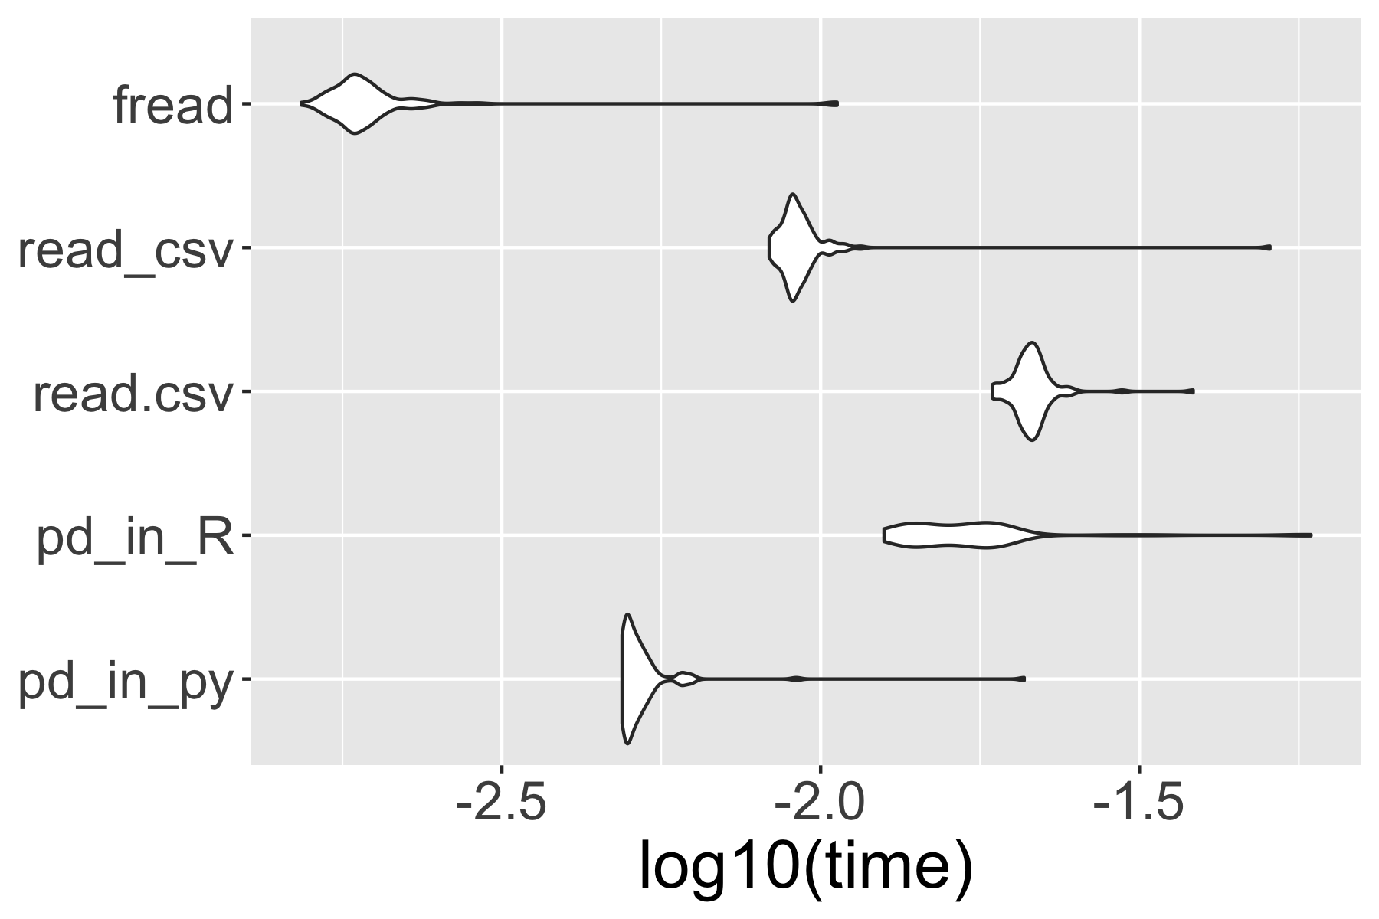
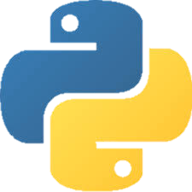
Benchmark visualization in R chunk

Slide 77
reticulate package
Calling Python from R in a variety of ways including R Markdown, sourcing Python scripts, importing Python modules, and using Python interactively within an R session.

Slide 78
reticulate package
Calling Python from R in a variety of ways including R Markdown, sourcing Python scripts, importing Python modules, and using Python interactively within an R session.

Slide 79
Run Python on Rstudio
1. Attach Python virtualenv in R
library(reticulate)
pyenv <- "<prj>/.venv/bin/python"
use_python(python = pyenv, required = TRUE)
2. Create .py file
File > New File > Python script
3. write in .py file
a = 1

Slide 80

https://www.amazon.co.jp/dp/B00Y0UI990/

Slide 81
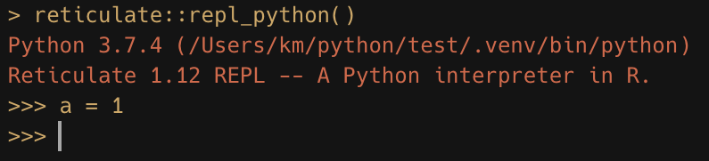

Slide 82
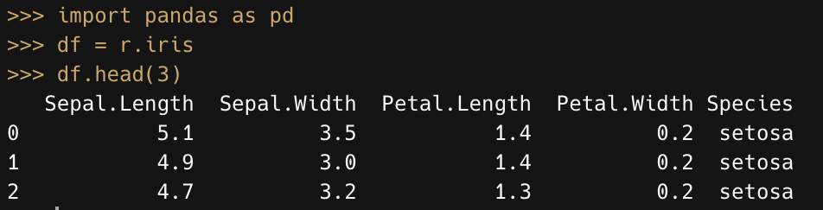

Slide 83
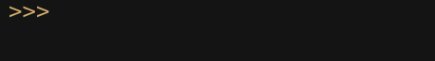
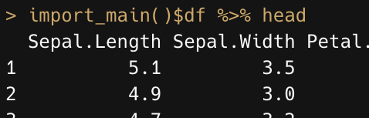
(escape key)

Slide 84
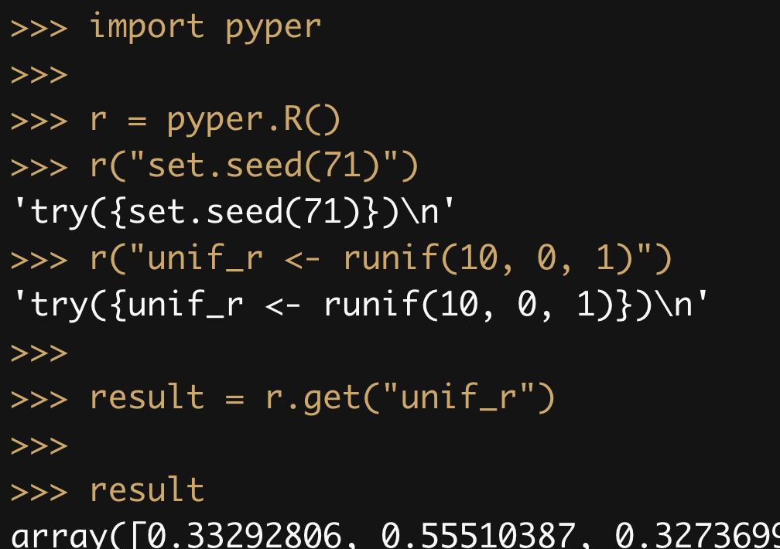

Slide 85
reticulate package
Calling Python from R in a variety of ways including R Markdown, sourcing Python scripts, importing Python modules, and using Python interactively within an R session.

Slide 86
summary

Slide 87
RStudio
Projects

Slide 88
"Sandboxed" Python
Isolated & Independent virtual environment for security & reproducibility
[python]
version = "3.7"
[packages]
cycler==0.10.0
kiwisolver==1.1.0
matplotlib==3.1.1
numpy==1.16.4
opencv-python==4.1.0.25
pandas==0.25.0
pyparsing==2.4.0
PypeR==1.1.2 ...
[python]
version = "2.7"
[packages]
numpy==1.16.4
...

Slide 89
Pipenv
→ "Sandboxed" Python manager
Create virtualenv
$ cd <project root>
$ pipenv --python 3.7
<project root>
.venv
← interpreter, env info
Pipfile
← package info

Slide 90
Use Python in R
Install reticulate from CRAN
install.packages(reticulate)
Attach Python virtualenv
library(reticulate)
pyenv <- "<prj>/.venv/bin/python"
use_python(python = pyenv, required = TRUE)

Slide 91
Use Python in R
Import Python source
pd <- import("pandas")
source_python("sample.py")
Shear pyobj between pychunks in Rmd
```{python}
import pandas as pd
path = "<path>/sample.csv"
df = pd.read_csv(path)
```

Slide 92
Run Python in Rstudio
1. Attach Python virtualenv in R
library(reticulate)
pyenv <- "<prj>/.venv/bin/python"
use_python(python = pyenv, required = TRUE)
2. Create .py file
File > New File > Python script
3. write in .py file
a = 1

Slide 93
reticulate package
Calling Python from R in a variety of ways including R Markdown, sourcing Python scripts, importing Python modules, and using Python interactively within an R session.

Slide 94
2
Do NOT start from here
Input
3
1
Whatever
Output
…

Slide 96
